Slide 1
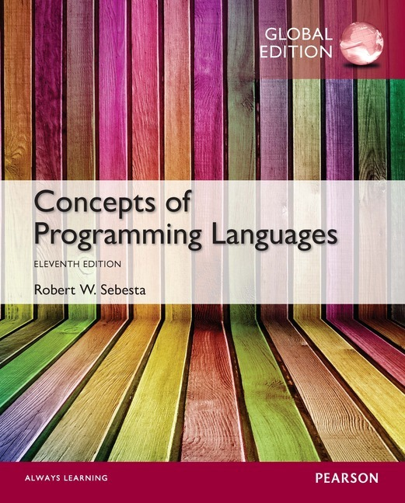
Chapter 2 Part 1
Evolution of the Major Programming Languages

Slide 2
Chapter 2 Topics
Zuse’s Plankalkül
Minimal Hardware Programming: Pseudocodes
The IBM 704 and Fortran
Functional Programming: LISP

Slide 3
Genealogy of Common Languages

Slide 4
Zuse’s Plankalkül
Designed in 1945 by Konrad Zuse
Never implemented
Not published until 1972
Used to specify fairly complex programs
Advanced data structures
floating point, arrays, nested records
Iterative for-like statement
Selection statement (no else)
Invariants
Similar to modern assertions

Slide 5
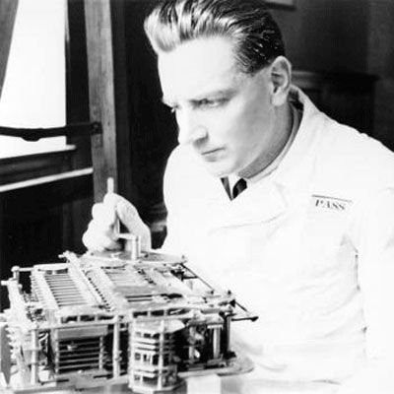
Zuse’s Plankalkül
Konrad Zuse with Z1 computer

Slide 6
Plankalkül Syntax
An assignment statement to assign the expression Z1[4]+1 to Z1[5]
| Z + 1 => Z
V | 1 1 (subindex)
K | 4 5 (subscript)
S | 1.n 1.n (data type)

Slide 7
Minimal Hardware Programming: Pseudocodes
Late 1940s and early 1950s
Programming done using machine code
Numeric codes to specify instructions
What was wrong with using machine code?
Expression coding was tedious
Poor readability
Poor modifiability
Absolute addressing
Machine deficiencies
No indexing for arrays or floating point operations

Slide 8
Pseudocodes: Short Code
By Mauchly in 1949 for BINAC computers
Purely interpreted (slow)
Expressions were coded, left to right
Example of operations:
01 – 06 abs value 1n (n+2)nd power
02 ) 07 + 2n (n+2)nd root
03 = 08 pause 4n if <= n
04 / 09 ( 58 print and tab
For example:
X0 = SQRT(ABS(Y0)) → 00 X0 03 20 06 Y0

Slide 9
Pseudocodes: Speedcoding
By Backus in 1954 for IBM 701
Pseudo ops for virtual arithmetic and math functions on floating point data
Auto-increment registers for array access
Conditional and unconditional branching
Interpreted, therefore slow!
Only 700 words left for user program

Slide 10
Pseudocodes: UNIVAC A-0, A-1, A-2
The UNIVAC “Compiling” Systems
Developed by a team led by Grace Hopper
Pseudocode expanded into machine code

Slide 11
Pseudocodes: Related Work
David J. Wheeler (Cambridge University)
Blocks of re-locatable addresses
Allowed for subroutines
Partially solved problem of absolute addressing

Slide 12
IBM 704 and Fortran
IBM Mathematical FORmula TRANslating System
Fortran 0 (1954)
Not implemented
Fortran I (1957)
Designed for the new IBM 704, which had index registers and floating point hardware
Floating point and array indexing not in software
Therefore no place to hide the cost of interpretation
Led to the idea of compiled programming languages

Slide 13
Design Process of Fortran
Environment of Fortran I development
IBM 704 had little memory, and was slow and unreliable
Applications were scientific and fairly simple
No programming methodology or tools
Machine efficiency was the most important concern
Impact of environment on Fortran I design
Compiled programs had to be fast!
No need for dynamic storage
Need good array handling and counting loops
No string handling, decimal arithmetic, or powerful input/output (for business software)

Slide 14
Fortran I Overview
First implemented version of Fortran
Names could have up to six characters
Post-test counting loop (DO)
Formatted I/O
User-defined subprograms
Three-way selection statement (arithmetic IF)
No data typing statements
Variable names starting with I, J, K, L, M or N were implicitly integers, all others were floating point

Slide 15
Fortran I Overview (continued)
First implemented version of Fortran
Compiler released in April 1957, after 18 worker-years of effort
No separate compilation
Programs larger than 400 lines rarely compiled correctly, mainly due to poor reliability of 704
Code was very fast
Quickly became widely used

Slide 16
Fortran II
Distributed in 1958
Independent compilation
More reliable compilation for longer programs
Shortened compilation process
Fixed the bugs

Slide 17
Fortran IV
Evolved during 1960-62
Explicit type declarations
Logical selection statement
Subprogram names could be parameters
ANSI standard in 1966

Slide 18
Fortran 77
Became the new standard in 1978
Character string handling
Logical loop control statement
An IF-THEN-ELSE statement

Slide 19
Fortran 90
Significantly different from Fortran 77
Modules
Dynamic arrays
Pointers
Recursion
A CASE statement
Parameter type checking
Relaxed fixed code format requirements
Some previous language features deprecated

Slide 20
Latest versions of Fortran
Fortran 95
Relatively minor additions
Some deletions
Fortran 2003
Support for OOP
Procedure pointers
Interoperability with C
Fortran 2008
Blocks with local scopes
Co-arrays
The DO CONCURRENT construct
Fortran 2018
Some relatively minor additions

Slide 21
Fortran Evaluation
Highly optimizing compilers
All versions before Fortran 90
The types and storage of all variables were fixed before run time
No support for recursion
Changed forever how computers are used
The lingua franca of the computing world

Slide 22
Functional Programming: LISP
LISt Processing language
Designed at MIT by John McCarthy
AI research needed a language to support
Processing data in lists (rather than arrays)
Symbolic computation (rather than numeric)
Recursive operation
Automatic dynamic storage handling
Only two data types
Atoms and lists
Syntax is based on lambda calculus

Slide 23
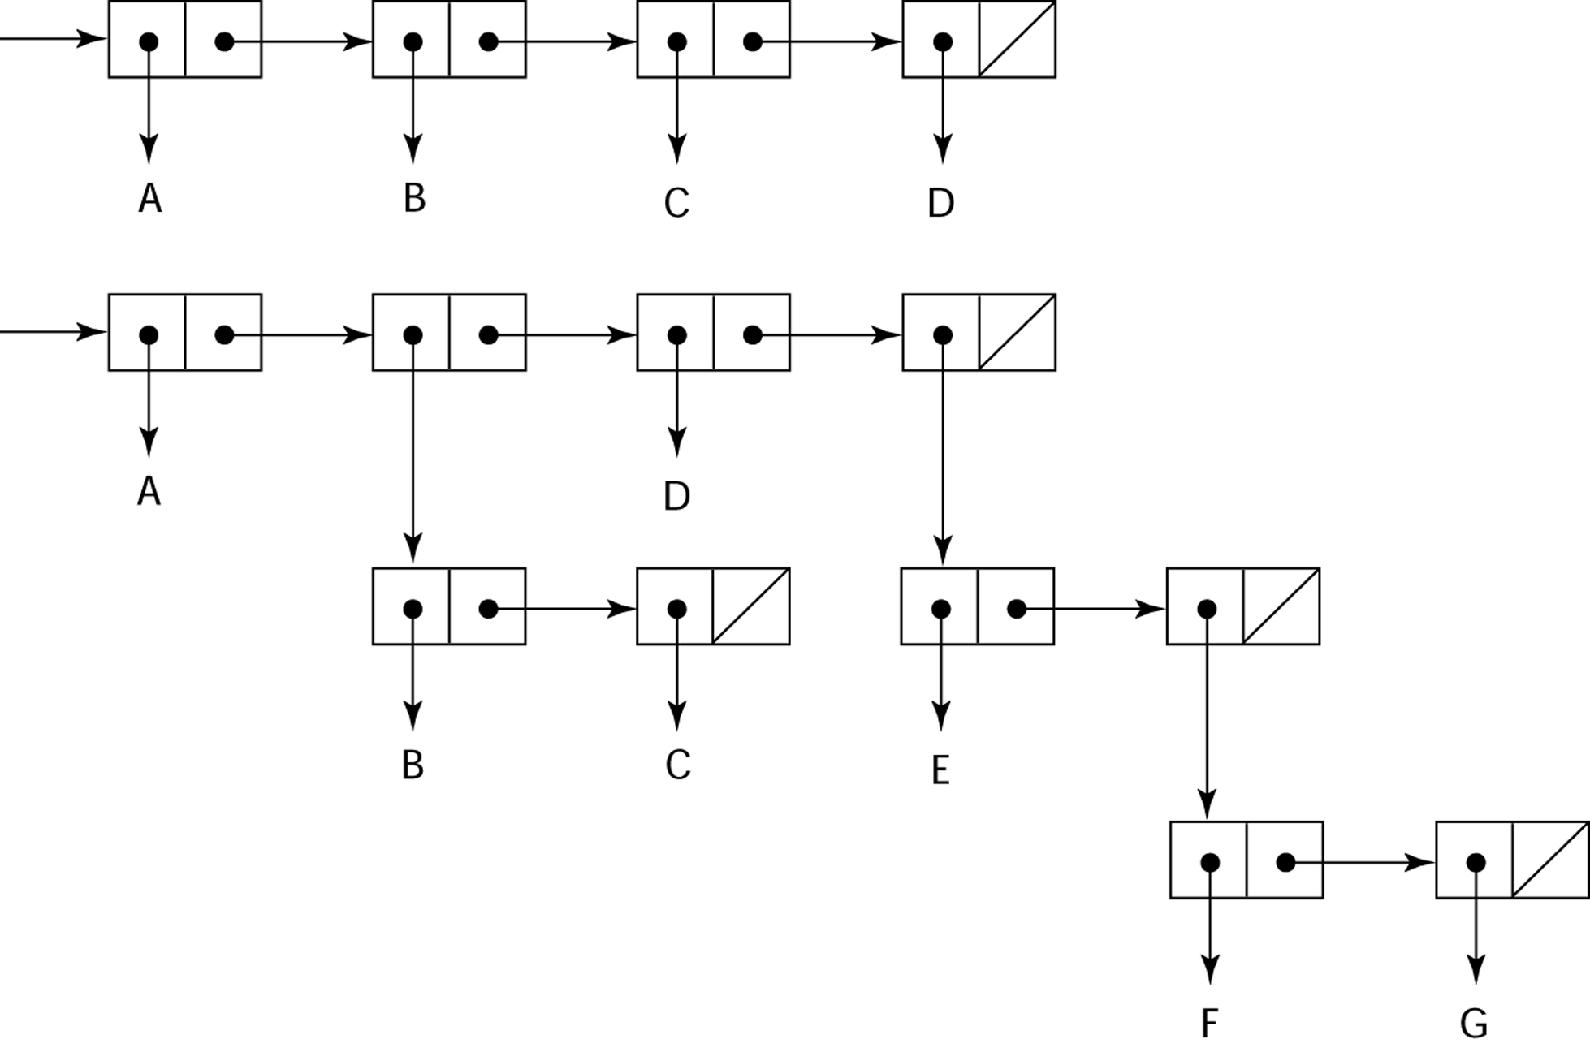
Representation of Two LISP Lists
Representing the lists (A B C D)
and (A (B C) D (E (F G)))

Slide 24
LISP Evaluation
Pioneered functional programming
No need for variables or assignment
Control via recursion & conditional expressions
Still an important language for AI
Contemporary dialects of LISP
COMMON LISP & Scheme
Other functional languages
ML, Haskell, and F#
Syntax very different from LISP

Slide 25
Scheme
Developed at MIT in mid 1970s
Small language, simple syntax
Ideal for educational applications
Exclusive use of static scoping
Functions as first-class entities
Functions can be applied to other functions
Functions can receive other functions as parameters
Functions can be results of function applications
Functions can be returned from other functions

Slide 26
COMMON LISP
Feature-rich dialect of LISP
Combines features of several LISP dialects
In many ways, the opposite of Scheme
Large and complex
Both static and dynamic scoping
Many data types and structures
Used in industry for some large applications

